Slide 1
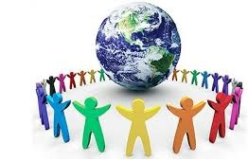
POLITICAL ORGANISATION OF SOCIETY
IN WHAT WAYS DO STATES AFFECT PEOPLE´S LIVES?
CARMINA RAMÍREZ
3 ESO

Slide 2
OBJECTIVES
ANALISE THE STRUCTURE OF A STATE.
UNDERSTAND THE IMPORTANCE OF DEMOCRACY AND STUDY THE PRINCIPAL FEATURES.
UNDERSTAND THE TERRITORIAL ORGANISATION OF SPAIN.
STUDY THE INTERNATIONAL RELATIONS AND GLOBALISATION.
EXPLAIN THE SUPRANATIONAL ORGANISATIONS AND NGO´S.

Slide 3
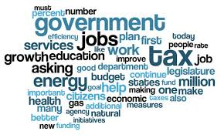
1. THE STATE
Is the basic way to organise a society.
A set of institutions created to organise the lives and activities of the people who live in the same territory and are governed under the same laws under the same authority (power).

Slide 4
1.
THE STATE
A. POPULATION
B. TERRITORY
C. POWER

Slide 5
A. Population
The people living in a state territory have a set of rights and duties that are the same for everyone.
People from different cultures and even nacionalities coexist in the same state.

Slide 6
B. TERRITORY
States are associated with the territory.
They are defined by borders
(that separate them from other states).
The state cannot make decisions or impose them by force outside their borders.

Slide 7
C. Power : Functions
Internal Order
Relationship between the States
Collects Taxes
Directs the economy
Administrates Public Services
Laws

Slide 8
2. Democracy

Slide 9
I. DEMOCRATIC STATES
Politics : all the activities related to the organisation and goverment of human society.
The first forms of political organisation were created in ancient times. Democratic States emerged in the 18th century.
They were based on 2 Principles:

Slide 10
Democracy
The State Recognises the rights and freedoms of individuals like:
1. The right of association. (form political parties , trade unions*, etc.)
2. Freedom of expresion, (strike)
Etc.
*Organisations that defend workers rights. They represent them.

Slide 11
Democracy
All citizens are equal before the law and have the right to vote (universal suffrage).

Slide 12
Democracy
Political Power: Belongs to people.
All citizens, without exception, submit to a fundamental law called the Constitution.

Slide 13
Constitution
Is the set of fundamental laws of the State.
Establish the rights and duties of the people.
Define the State´s institutions and operations.
( define the functions of the States Institutions).

Slide 14
Democratic Systems
Sovereignty is held by the people.
Citizens elect their political representatives.
The choice is made through an electoral system called universal suffrage.
Democracies are multi-party.
The parties respond to different ideologies.

Slide 15
Democratic Regimes can be:
A. Parliamentary Monarchy.
The king is the head of the State .
King reigns, but does not govern.
Swear loyalty to the Constitution .
Sovereignty is held by the people.
B: Republic.
No king.
President chosen by citizens.
Sovereignty is held by the people.

Slide 16
SPAIN
State Organisation
POLITICAL
ORGANISATION
Legislative
Power
Executive
Power
TERRITORIAL
ORGANISATION
Judicial
Power
Democratic State
Constitution
Municipalities
Provinces
Autonomus Communities
Thanks to:
1978
Powers separation
People Soberanity
That Establishes:

Slide 17
SPAIN
Spain is a Democratic State, based on national sovereignty and universal suffrage.
The Spanish State is a Parliamentary monarchy.
The king is the head of the State, the head of the army, the symbol of its unity and its highest representative, but has no political power.

Slide 18
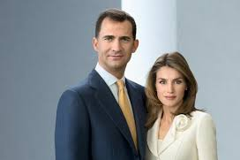
Parliamentary Monarchy: Spain
The political system in Spain is regulated by the Spanish Constitution, which was ratified by the referendum on the 6th December 1978.
The constitution includes the fundamental principles of the Spanish State:

Slide 19
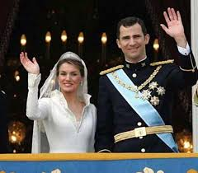
Spain is a Parliamentary Monarchy= Type of monarchy in which the king has no real, political power.
2. Swear loyalty to the Constitution. It is said that the:“King reigns, but does not govern”.

Slide 20
King´s functions
Represents the State.
Is the referee and chair of the different spanish Institutions.
Advisor ( Parliament, Government, justice tribunals).
Is the highest International Relations representative.
King is hereditary and for lifetime.
He can´t create laws.
He can´t judge

Slide 21
Spanish Monarchy
Brief history of the Spanish Royal Dynasty
https://www.youtube.com/watch?v=1HQGBFwRi_Q
6 min.

Slide 23
Democracy
Agents
1.
DIVISION OF POWERS
2.
ELECTIONS
3.
POLITICAL PARTIES

Slide 24
1.
A
B
C

Slide 25
A. Legislative Power
Excercised by Cortes Generales. (Houses of Parliament)
Congress of Deputies and Senate.

Slide 26
B. Executive Power
Exercised by the government,
which is responsable for applying laws and taking political decisions.

Slide 27
Ministers
. Presidency

Slide 28
C. Judicial Power
Excercised by judges, who are responsible for passing judgment and resolving conflicts in accordance with the law, so guaranteeing that the laws is enforced.

Slide 29
2. ELECTIONS
Are the two types of mechanisms by which citizens are involved in the exercise of power through voting.
Can be :
A. Direct (Referendum).
B. Representative (Elections).

Slide 30
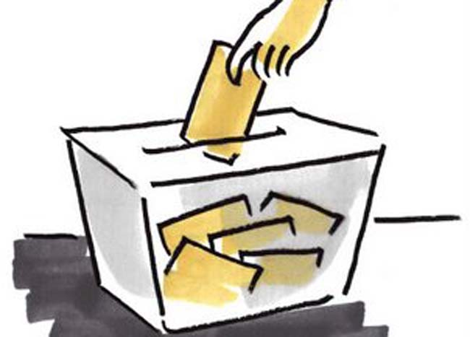
A. Direct (Referendums)
When citizens make decisions in assemblies or through referendums.
Citizens vote on a particular proposal.

Slide 31
B. Elections
Citizens choose their political representatives in government by voting elections.

Slide 32
3. Political Parties
Democracies are multi-party.
The parties respond to different ideologies.

Slide 33
II. Non-Democratic Regimes
Political parties are prohibited.
In some of them there is only one party with authoritarian government.
Don´t exist :
Citizens rights
Separation of powers
Equality before the law

Slide 34
Non – democratic regimes
Theocratic
Communist
Absolute monarchies
Military or presidential dictatorships

Slide 35
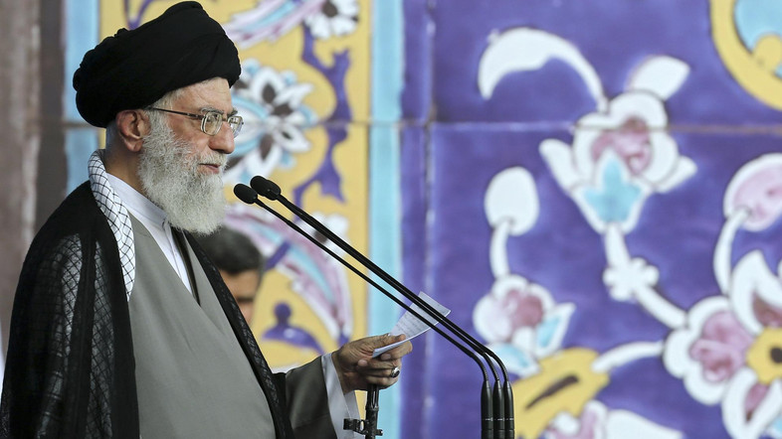
Theocratic
The legimacy of power is based on religious principles.
The power is excercised by religious authorities.
Sacred books and texts are the basis of law.
E.g. Irán

Slide 36
Communist
All policy decisions are channelled through a single party that controls government bodies.
Nowadays few countries have this regime.
E.g. North Korea, Cuba.

Slide 37
Absolute Monarchies
A king or Emperor governs with absolute or dictatorial rule.
The king relays on collaborators elected directly by him.
E.g. Saudi Arabia .
https://www.youtube.com/watch?v=TZNQDxBCC20&index=1&list=PLxCfhcp_1V5ZacnntTuJENaTUfXNUnGUF&spfreload=10

Slide 38
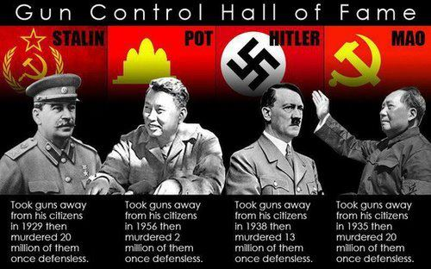
Military or presidential Dictatorship
Freedom is restricted and power is controlled by a military or political elite.

Slide 39
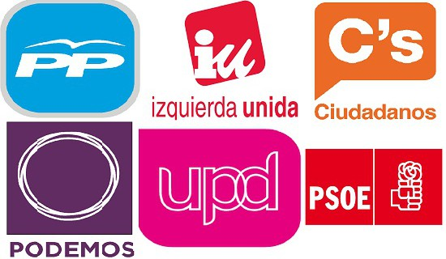
3. Political Parties
http://www.huffingtonpost.com/entry/spain-election-race_us_56717a8ee4b0 648fe301a3c8

Slide 40
3. Territorial Organisation of Spain
According to the Constitution the Spanish Territory is organised into:
a. Municipalities
b. Provinces
c. Autonomous communities.

Slide 41
a. Municipalites
A municipality is the most basic administrative division of the Spanish Territory.
It consists of one or more population centres.
It is governed by a local authority.
Spain has 8 122 municipalities.
Municipalities obtain their resources from taxes provided by the State and the autonomus community.
The head of the Municipality is the Major (City Hall)

Slide 42
Municipal services
Public lighting,
Rubish collection,
Road cleaning,
Supply drinking water, sewers
Paving,
Cementeries.

Slide 43
Muncipalities with more than 5000 inhabitants
Provide:
Public parks,
Library,
Market,
Waste treatment facilities.

Slide 44
Muncipalities with more than 20 000 inhabitants
Provide:
Civil protection,
Social services,
Fire brigade,
Public sports,
Etc.

Slide 45
b. Provinces
A province is an administrative division made up of municipalities.
It is a territorial division and also a local authority, since it provides services and municipalities.
The current provinces were created in 1833 .
50 Provinces.

Slide 46
A province has several functions:
1. It is an electoral district for national elections.
2. It serves as a territorial division for the central government.
3. The specific mission is to help municipalities manage certain services and activities.

Slide 47
c. Autonomous Communities
These are a form of state descentralisation.
According to the Constitution, regions with common historical, cultural and economic characteristics may become autonomous communities.
In 1979-1983 the 17 autonomous communities were created. (7 have only one province)
In 1995 2 cities : Ceuta and Melilla became autonomous cities.

Slide 48
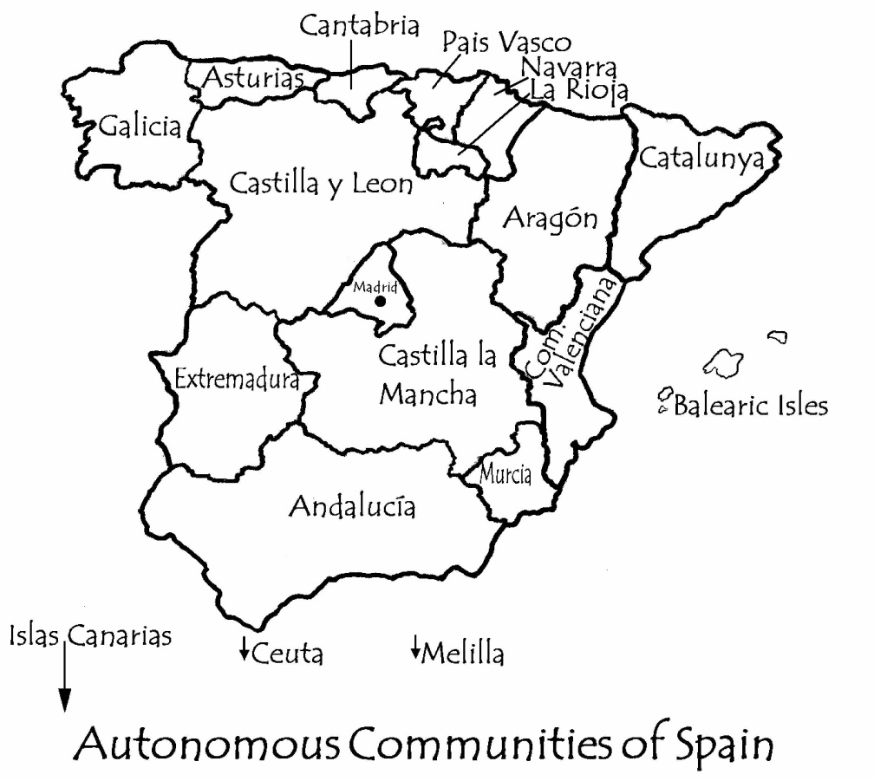
Autonomous Communities

Slide 49
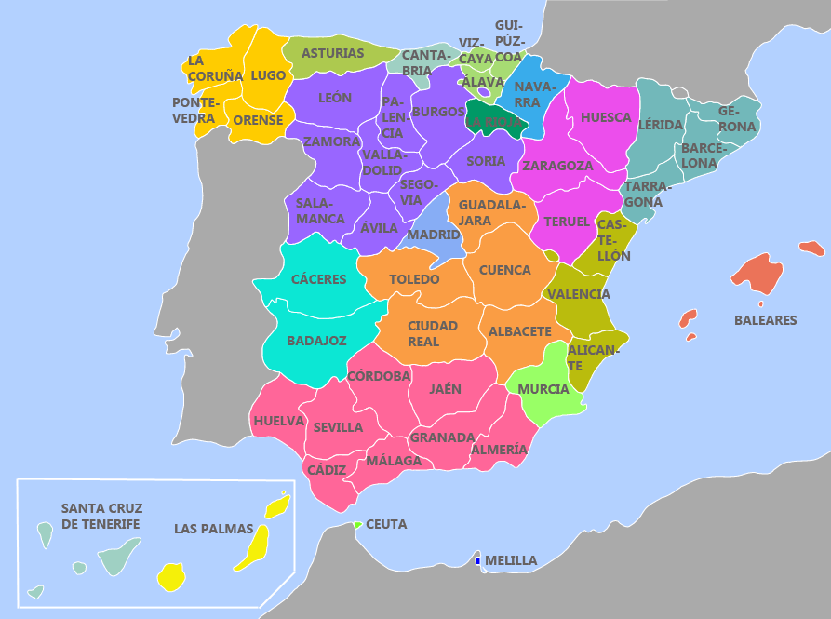
Provinces in Spain

Slide 50
Autonomous government Institutions
An Assemble or Parliament (legislative Assembly)
The President
The Goverment or Council

